Slide 1
EXAMINATION OF LUMP OR A SWELLING
Dr.M.P.LAL. Professor and Head Dept of Surgery

Slide 2
LUMP
Vague mass or swelling

Slide 3
SWELLING
A vague term which denotes any enlargement or protuberance in the body & may include tumours

Slide 4
NEOPLASM or TUMOUR
Growth of new cells which proliferates independent the need of body

Slide 5
HISTORY
Duration /Onset / Other symptoms with lump/Pain/ Progress of swelling/ site /fever/other lumps/

Slide 6
HISTORY
Secondary changes/Impairment of functions/Recurrence of swelling/loss of body weight/past , personal & family history

Slide 7
PHYSICAL EXAMINATION
General survey Local examination. General examination

Slide 8
LOCAL EXAMINATION
INSPECTION /PALPATION /STATE OF REGIONAL LYMPH NODES. /PERCUSSION /AUSCULTATION/ MEASUREMENTS /MOVEMENTS / EXAMINATION FOR PRESSURE EFFECT

Slide 9
INSPECTION.
Situation/Shape/Edge/Number/Pulsation/Peristalsis/Movement with respiration/Impulse on coughing/

Slide 10
INSPECTION.
Movement on deglutition/Movement with protrusion of tongue/Skin over the swelling/Any pressure effect

Slide 11
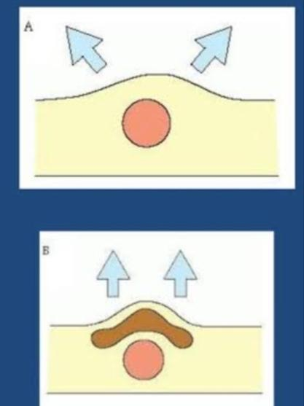

Slide 12
PALPATION
Temperature. /Tenderness/Size , Shape & Extent/Surface/Edge/Consistency /Fluctuation. /Fluid thrill/ Translucency/

Slide 13
PALPATION
Impulse on coughing/Reducibility/compressibility/ Pulsatility/ Fixity to the overlying skin/ Relation to surrounding structures

Slide 15
SPECIAL INVESTIGATION
Blood/ Urine/Aspiration/FNAB or FNAC/X-ray/Skin test/Ultrasonography/CT scan/MRI/Angiography/Biopsy/Follow-up in case of malignancy.

